Slide 1
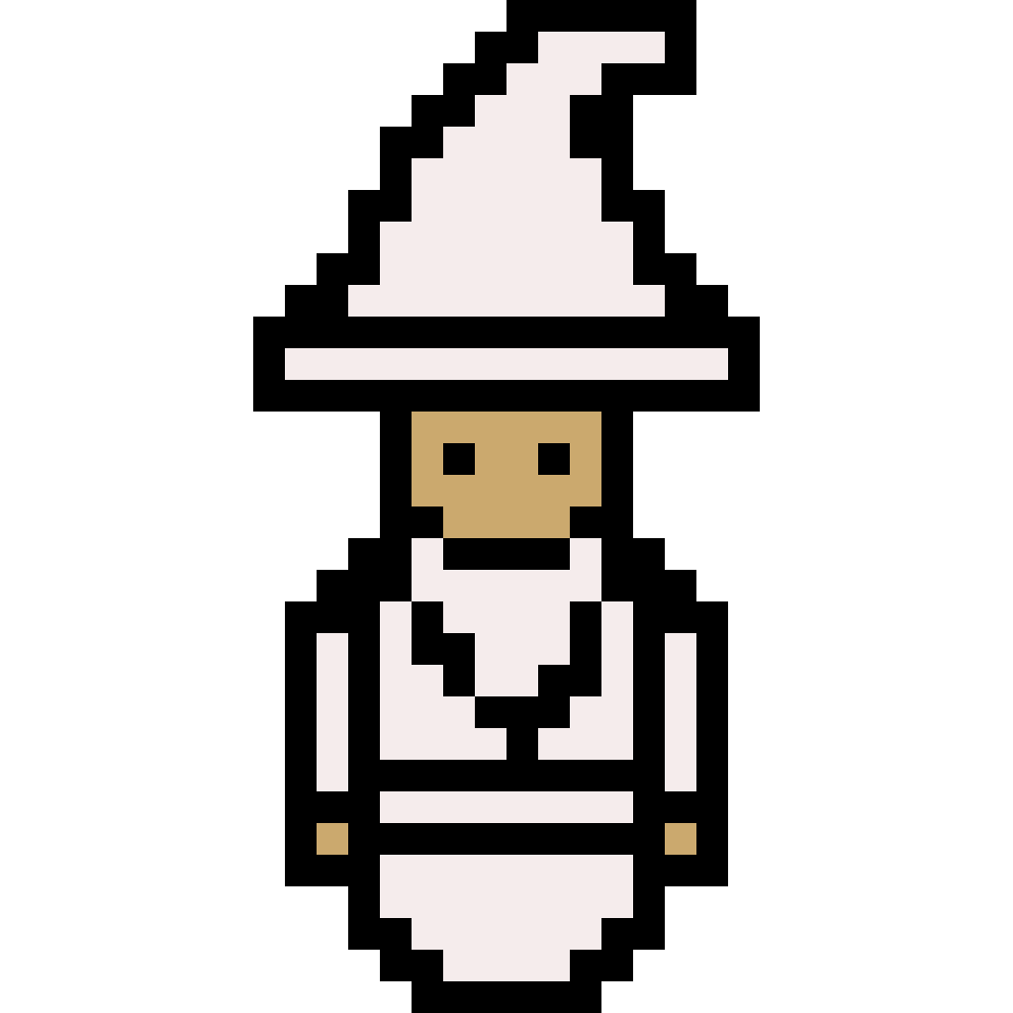
SpelliNg Test
Yu-Ching Ho
Nathanael Omnes
David Byron

Slide 2
Introduction
Spelling Test will mix top-down shooter and rpg mechanics to create a game with the rich story and progression of an RPG with the challenging real-time combat and boss battles of a well made action shooter.
Spelling Test was inspired by several different games, most notably the critical-success, The Binding of Isaac
Notes:
nath

Slide 3
Story
Our story begins with a young apprentice Wizard being kicked out of the ‘Wizard Tower’ by the master there, who tells him he doesn’t have what it takes to ever become a full-fledged Wizard
Determined to prove him wrong, our protagonist begins his journey to travel to the different elemental sites of magical power and defeat their Guardian Wizards to prove his worth
After defeating these Guardians and learning their secrets, our hero will return for a final showdown with his old master, the most powerful Wizard in the land
Notes:
david

Slide 4
Gameplay
Spelling Test will have two main areas of gameplay:
Overworld - In the overworld map, the player can travel to different locations on the world map, talk to NPCs and several other non-combat interactions
Battles - The game will have a unique battle map and unique battle mechanic for each Guardian battle in the game and one for the final boss
Notes:
Yoshi

Slide 5
Gameplay
The player will learn new spells on his travels, being able to use a spell of each elemental type when he defeats the linked Guardian
The combat mechanics will increase in complexity as the game progresses and the player collects new spells.
Spells will be more than simple re-coloured projectiles, there will be several utility spells (eg Earth shield, Ice Wall etc) to give the player a fun toolkit to utilise
Notes:
yoshi

Slide 6
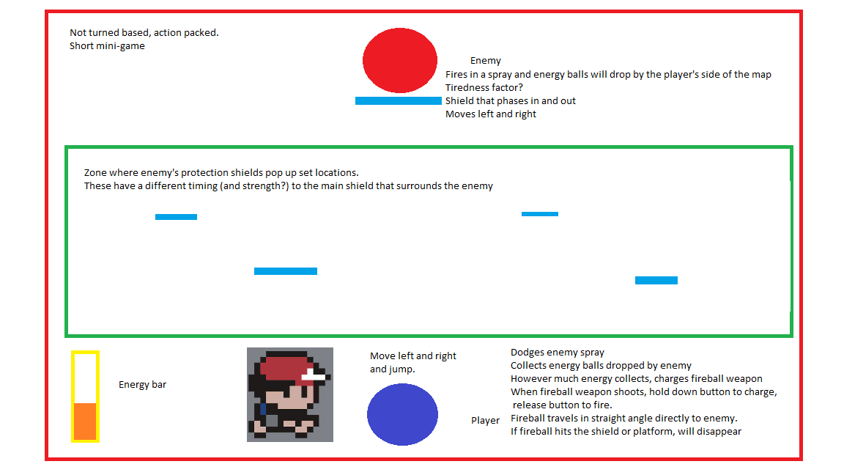
Gameplay
An early prototype idea for one of the many boss battles we will have in the game:
Each one will be different!
Notes:
yoshi

Slide 7
Characters
Apprentice Wizard - Our main character - nameable by the Player
Master Wizard - The final boss and may appear to influence the story at a certain point in the game
Elemental Guardians - Elemental masters who guard the secrets of the sites of power
Assorted NPCs - they may have information for the player, provide side quests and more
Notes:
david

Slide 8
Graphics
Spelling Test will use a simple pixel art style. By choosing to make the game 2D with a simple, colourful aesthetic, we can make the game world itself larger, more interesting and more content-rich. A Retro-style also fits the game world very well
We will use software such as Photoshop and PISKEL to create the sprites, backgrounds and images required for the game
Notes:
david

Slide 9
Audio
Spelling Test will again remain true to the Retro theme and use simple 16-bit sounds and chiptunes to provide the main audio.
Potential for some unique music and effects courtesy of a Music Tech contact of the group
We will primarily use AUDACITY for sound editing and perhaps take advantage of stock chiptunes, music and effects for our non-original sound
Notes:
nath

Slide 10
Platform & Pricing
Spelling Test would be best suited to PC, but could also work well as a handheld or mobile game
The game would be released as Free-to-Play on both PC and mobile with perhaps an advertisement-based model to generate some revenue
If it proves popular, Spelling Test could be released on Steam with added features and new updates for a very small price
Notes:
david

Slide 11
Target Market
Spelling Test should be an attractive game for all audiences and ages. The Retro-aesthetic is well liked by all sorts of different gamers
The steadily increasing challenge of the game and the interesting mix of genres should also attract experienced gamers looking for something different
We can conduct some market research using UWS students as a base to find out more concrete data about the type of player-base our game will attract
Notes:
david

Slide 12
Risk analysis (Project)
Risks | Probability (⅕) | Severity(⅕) | Risk level
A late change of game engine | 1 | 4 | 4
Lateness/non-participation | 2 | 3 | 6
Bad team communication | 2 | 3 | 6
Missing work | 3 | 3 | 9
Notes:
Nath, unity

Slide 13
Risk analysis (Game)
Risks | Probability (⅕) | Severity(⅕) | Risk level
Visual attractiveness | 2 | 1 | 2
Too difficult/easy | 3 | 2 | 6
Mechanics not enjoyable | 2 | 3 | 6
Not understandable | 2 | 4 | 8
Too many bugs | 3 | 3 | 9
Notes:
david

Slide 14


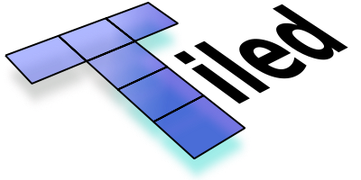





Software
Notes:
yoshi

Slide 15
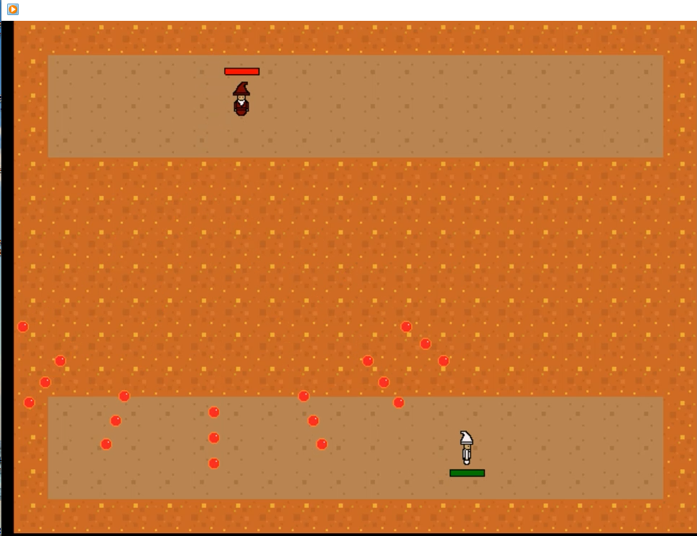
Prototype Demo
Notes:
yoshi

Slide 16

Questions?

